Slide 1
Storage Devices
Primary storage: is the storage provided
by memory in a computer system
e.g. ROM/RAM.
Secondary storage: is storage provided
by peripheral devices other than memory

Slide 2
Storage Devices
Secondary storage: is required in a computer
system for three reasons
The content of memory is usually volatile, which means that if power is disconnected the data is lost.
2. The capacity in megabytes of memory is limited.
3. Memory is more expensive than secondary
storage.

Slide 3
Storage Devices
Several types of disks may be used for
Secondary storage.
Floppy disks
Hard disks
Optical disks (including CD-ROM, writeable CD, DVD
Backup Storage Devices e.g. tape

Slide 4
Storage Devices
Floppy Disk
A floppy disk is a low capacity disk which may be
removed from the computer.
There are two types:
Those holding a small amount of data (typically
1.44 Mb
And ‘Super floppies’ known as ZIP disks (typically
100 Mb
Data may be written to and read from a floppy. A
small notch can be used to make the disk read-only

Slide 5
Storage Devices
Floppy Disk
They are small lightweight and easy to transport.
Ideal for backups of small amounts of data or for
transfer of data from one machine to another.
Floppy Drives are common to most if not all
computers.
On the down side, they may be easily misplaced,
damaged or stolen.
There is a risk of transferring VIRUSES

Slide 6
Storage Devices
Hard Disk
A hard disk is a higher capacity medium, with up to
hundreds of gigabytes.
They are usually non-removable, but removable
hard disks are becoming more common.
They can be both read from and written to, and are
the standard medium for storage on computer
systems today.

Slide 7
Storage Devices
Hard Disk
Hard disks are manufactured in metal and coated
with a magnetisable recording medium, similar to
the material used in a floppy disk or audio tape.
Depending on the storage capacity of the unit, it
may comprise a number of disks each having its own
read/write head.
Hard disks are much faster than floppy disks and
can store much larger amounts of data.

Slide 8
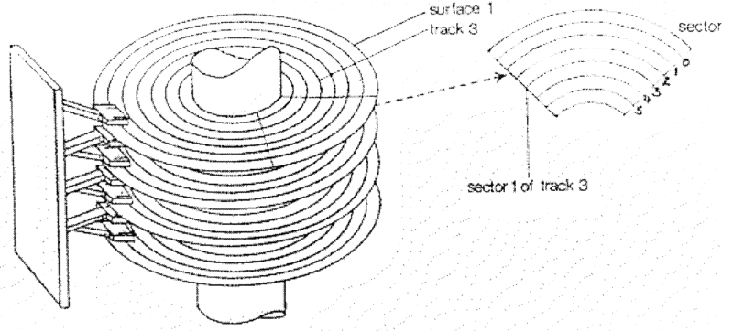
Storage Devices
Hard Disk

Slide 9
Storage Devices
Hard Disk
You can see from the previous diagram a hard disk
is made up of Sectors, Tracks and Cylinders.
The specification of a hard disk depends not only
on its capacity but also:
Access time to data. This is affected by the rotation
Speed of the disk and also the way in which the disk
Is connected to the motherboard – standard being
SCSI and IDE

Slide 10
Storage Devices
Optical disks
CD ROM = Compact Disk Read Only Memory, is an
ideal device for storing large quantities of data and
information such as large software packages.
The CD drive uses laser technology to read the disk
contents and therefore both access and transfer
are extremely fast.
With a typical capacity of 600 Mb they are used for
software supply, reference material such as
Encyclopaedias and games.

Slide 11
Storage Devices
Optical disks
CD ROM as the name suggests is Read Only
Writable CDs allow for large amounts of data to be
written to a CD as well as read from it. They are
sometimes know as CD-RW.
For these, a CD drive is needed which includes write
heads as well as read heads

Slide 12
Storage Devices
Optical disks
DVD or Digital Versatile Disk is a higher capacity
version of a CD and DVD drives have a higher
transfer rate.
DVD disks provide high quality playback of films and
audio and are increasingly found as standard on the
home PC.
DVDs may be read only or read/write. They are
sometimes know as DVD-ROM and DVD-RAM.

Slide 13
Storage Devices
Optical disks
DVD disks are double sided so data is stored on
both sides of the disk.
DVD technology uses a very shortwave laser beam
to read pits from the spinning disk
DVD disks typically holds 4.7 Gbytes of data
Rewritable disks can be re-used thousands of times.

Slide 14
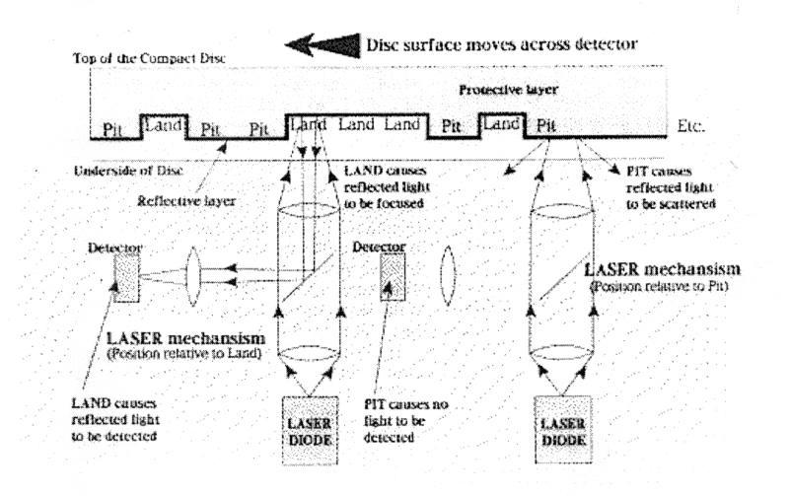
Storage Devices
Optical disks

Slide 15
Storage Devices
Backup Storage Devices
It is vital that all files stored in a computer system
are backed up regularly.
There are several high capacity devices.
These include:
Cartridge tape back-up drives, which can hold up to
10 Gigabytes on a single tape.
Zip disk drives, which holds 100 Megabytes.
Jaz disk drives, which holds 1 or 2 Gigabytes
Super floppy disk drives which can hold up to 120 Mb
CD writers, which hold 680 Megabytes

Slide 16
Storage Devices
Exercises
What is Primary Storage?
What is Secondary Storage?
What material is a floppy disk made from?
When the small window on one corner of a floppy disk is closed, the disk is write protected TRUE or FALSE?
Give two advantages of floppy disks.
A Hard drive has cylinders, and
Hard drives have read/ heads.
The specification of a hard disk depends on:
1.
2.
3.
9. What does SCSI stand for?

Slide 17
Storage Devices
Exercises
Optical disks use which technology?
CDs are read only TRUE or FALSE? Explain.
Why is a DVD of higher capacity, compared to a CD?
DVDs are read only TRUE or FALSE?
DVD disks typically holds
Do you need to back up a hard disk?
List five backup storage devices.
1.
2.
3.
4.
5.

